Slide 1

MARATHWADA MITRA MANDAL’S COLLEGE OF ENGINEERING Karvenagar, Pune Accredited with ‘A’ Grade by NAAC
PROJECT REVIEW
BANK LOCKER SECURITY SYSTEM
Project Guide: Prof. (Mrs.) Manisha Dudhedia
Group members: 1.Vaishnavi Chourasiya 71914092H
2.Virashree Jadhav 71914188F
3.Srushti Karpe 71914221M

Slide 2
OUTLINES
INTRODUCTION
LITERATURE SURVEY
PROBLEM STATEMENT
MODULES
TOOLS REQUIRED
SPECIFICATIONS
BLOCK DIAGRAM
DEMERITS
MERITS
FUTURE SCOPE
CONCLUSION
TIMELINE
REFERENCES

Slide 3
INTRODUCTION
In today's world, safety is a major factor. Everyone has valuable assets such as gold, jewellery or cash. It is not enough to have these resources, but the security of this is very important, for this purpose we keep it in the banking sector. Yet we often hear or read in the newspapers that someone fake got into someone else’s closet and stole money. To overcome this kind of fraud, the confirmation of the person you want to use the lock is very important. Face recognition is the process of identifying something that has already been discovered as a known or unknown face. The problem of facial recognition is often confused with the problem of facial recognition. Face Identification, on the other hand, determines whether a "face" is a known person, or an unknown person, using this purpose on the face website to verify this facial expression.

Slide 4
LITERATURE SURVEY
Author | Article | Used method | challeges | Constrain
Dhananjay Garud ,Dr. S.S. Agrawal | Face Liveliness Detection | These features are input to the SVM classifier to which detects the liveness of user. | Various challenges such as pose, illumination, expression, aging variations, and occlusion | we will decrease the processing time and some problems in bright light environment. This system work only for one person at a time, in future we try for multiple persons
Avinash Kumar Singh, Piyush Joshi, G. C. Nandi | Face Recognition with Liveliness Detection using Eye and Mouth Movement | HAAR Classifier, Principal Component Analysis. | it is proven that, to bypass the liveness test, attacker has to remove eye and mouth region of the photograph and has to place his eye and mouth instea | attack is able to bypass the liveness test but it creates massive changes in face structure. Therefore resultant unrecognized or misclassified by the face recognition module
Chun-Hsiao Yeh Herng-Hua Chang | Face Liveliness Detection Based on Perceptual Image Quality Assessment Features with Multi-scale Analysis | perceptual image quality assessment features with multiscale analysis | the incorporation of the image quality assessment knowledge into face liveness detection is promising to improve the overall accuracy | The proposed framework took advantage of the BIQE, EPSD, and GMS by selecting effective pixels to create the most appropriate image quality features for face liveness detection.
JUNYAN PENG, PATRICK P. K. CHAN | Face Liveliness Detection For Combating The Spoofing Attack In Face Recognition | Dynamic High Frequency Descriptor (DHFD) and the original High Frequency Descriptor (HFD) under different resolution for capturing image | user by showing the photograph or video clips in front of the camera of the authorization system. The decision of the system may be misled | the difference of high frequency components energy between images with and without additional illuminationsolution screen,

Slide 5
PROBLEM STATEMENT
The general public has immense need for security measures against spoof attack.
The face recognition can be used for bank locker security but it can be easily hacked if somebody uses photograph of person, so there is need for liveliness detection along with face Recognition.

Slide 6
MODULES
Image Acquisition:
The camera will be interfaced to locker which will be controlled by python interface
Face Detection:
Facial Landmarks can be used to detect Face of person
Face Recognition:
Neural Network can be trained to recognize faces of user
Liveliness Detection:
Eye blink detection algorithm can be used to detect liveliness
Access Control:
Finally access control is achieved based on face & liveliness Detection

Slide 7
TOOLS REQUIRED
SOFTWARE
HARDWARE
PYTHON IDLE
ARDUINO UNO
1
1
VISUAL STUDIO CODE
SERVOMOTOR(SG90)
2
2
ARDUINO IDE
LAPTOP
3
3
4
4

Slide 8
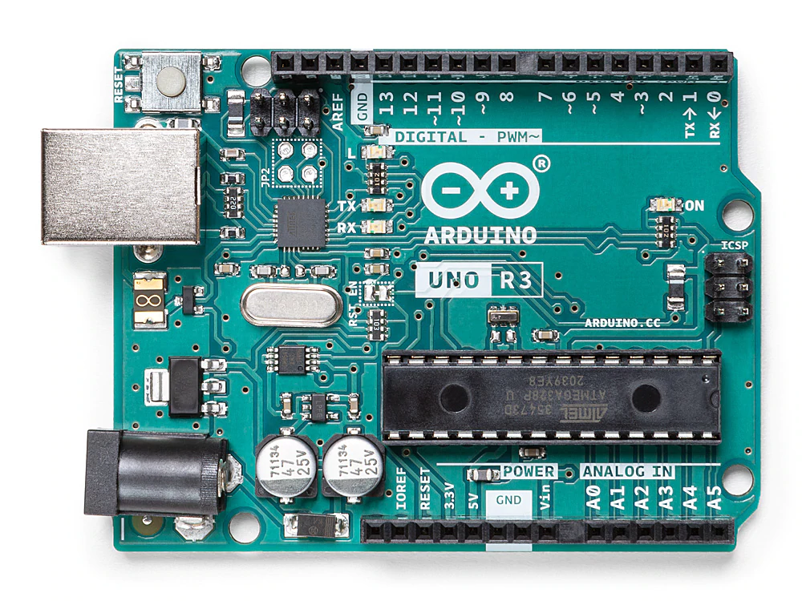
SPECIFICATIONS ARDUINO UNO
Microcontroller: ATmega328P
Operating Voltage: 5V
Input Voltage (recommended): 7-12V
Inout Voltage (limit): 6-20V
DC Current per I/O Pin: 20 mA
DC current for 3.3V Pin: 50 mA
Flash Memory: 32 KB (ATmega328P)
SRAM: 2 KB (ATmega328P)
EEPROM: 1 KB (ATmega328P)
Clock Speed: 16 MHz
LED_BUILTIN: 13
Length: 68.6 mm Width: 58.4 mm Weight: 25 g

Slide 9
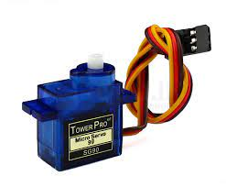
SERVO MOTOR (SG90)
Torque: 2.0kg/cm(4.8V), 2.2kg/cm(6V)
Speed: 0.09s/60°(4.8V), 0.08s/60°(6V)
Rotate angle: 180°
Operating voltage: 4.8 ~ 6V
Gear: plastic
Dead band: 7us
Weight: 10.5g
Dimension: 22.8mm × 12.2mm × 28.5mm

Slide 10
BLOCK DIAGRAM
Face training database
Face Image
Face Image normalization
User
Image Acquiring
Preprocessing
Liveliness detection
Classification
Face known or unknown
Bank locker

Slide 11
DEMERITS OF EXISTING SYSTEMS
The present system is less efficient in many ways.
The records of the customers accessing the vaults maybe lost or ruined by some external source.
Similarly a customer's fingerprint can be easily forged.
The existing system can also allow the intruders to break in easily due to it's pure security mechanism.

Slide 12
MERITS OF PROPOSED SYSTEM
System used for locker security.
Security against vulnerabilities such as spoofing, tampering, masquerade attack etc.
There is no retention of the template or image.
Improved authentication, security assurance. Maintaining Privacy and secrecy.
It can be implemented in large scale application and public domain with required authorization.

Slide 13
FUTURE SCOPE
1. The System can be implemented in embedded processors such as raspberry PI
2. Additional Securities can be used such as fingerprint recognition
3. The System can be further extended to other banking services

Slide 14
CONCLUSION
This system provides a simple path for the future development of novel and more secured face liveliness detection approach for bank locker security.

Slide 15
TIMELINE
September:
Searching for project ideas
Finalizing the domain
Shortlisting project topics
October & November:
Approval of the topic
Collected basic information related to the project
Studying the Research Papers
Preparing Dataset
Training the model
December & January:
Capturing image using OpenCV library
Connecting camera and trained model
Submission of Synopsis
Submission of initial Report & PPT
February & March:
Use of image matching algorithm
Implementation of Software
Developing user-interface
April:
Implementation of Hardware
Testing the entire model
Final Project Report Submission

Slide 16
REFERENCES
[1] Tanvir Ahmed , Al Amin , Mohammad Ashraful Hoque”Autonomous Face Detection System from Real time Video Streaming for Ensuring the Intelligence Security System”[2020]
[2] Sumit Sidana “Recommendation systems for online advertising”,Computers and Society [cs.CY],2019
[3] Jinesh Mehta, Eshaan Ramnani, and Sanjay Singh “Face Detection and Tagging using Deep Learning”,International Conference on Computer, Communication, and Signal Processing (ICCCSP),2018
[4] T.Thiraviyam “ARTIFICIAL INTELLIGENCE MARKETING”,International Journal of Recent Research Aspects,2018
[5] Daniel S´aez Trigueros “Face Recognition: From Traditional to Deep Learning Methods” ,arXiv,2018

Slide 17
[6] Manik Sharma, J Anuradha, H K Manne and G S C Kashyap “Facial detection using deep learning”,IOP Conference Series: Materials Science and Engineering,2017
[7] Srikar Appalaraju,Vineet Chaoji “Image similarity using Deep CNN and Curriculum Learning”,arXiv,2017
[8] Daniel Fleder and Kartik Hosanagar “Recommender Systems and their Impact on Sales Diversity”,EC'07 - Proceedings of the Eighth Annual Conference on Electronic Commerce,2017
[9] Tianyi Liu, Shuangsag Fang, Yuehui Zhao, Peng Wang, Jun Zhang “Implementation of Training Convolutional Neural Networks”arXiv,2016
[10] S. Muthuselvi and P. Prabhu “DIGITAL IMAGE PROCESSING TECHNIQUES – A SURVEY” International Multidisciplinary Research Journal,2016

Slide 18
THANK YOU

